Slide 1
Machine Learning
Internship Project

Slide 2
Micro-Credit Project

Slide 3
df.describe()
Unnamed: 0 label aon daily_decr30 daily_decr90 rental30 rental90 last_rech_date_ma last_rech_date_da last_rech_amt_ma ... cnt_loans30 amnt_loans30 maxamnt_loans30 medianamnt_loans30 cnt_loans90 amnt_loans90 maxamnt_loans90 medianamnt_loans90 payback30 payback90
count 209593.000000 209593.000000 209593.000000 209593.000000 209593.000000 209593.000000 209593.000000 209593.000000 209593.000000 209593.000000 ... 209593.000000 209593.000000 209593.000000 209593.000000 209593.000000 209593.000000 209593.000000 209593.000000 209593.000000 209593.000000
mean 104797.000000 0.875177 8112.343445 5381.402289 6082.515068 2692.581910 3483.406534 3755.847800 3712.202921 2064.452797 ... 2.758981 17.952021 274.658747 0.054029 18.520919 23.645398 6.703134 0.046077 3.398826 4.321485
std 60504.431823 0.330519 75696.082531 9220.623400 10918.812767 4308.586781 5770.461279 53905.892230 53374.833430 2370.786034 ... 2.554502 17.379741 4245.264648 0.218039 224.797423 26.469861 2.103864 0.200692 8.813729 10.308108
min 1.000000 0.000000 -48.000000 -93.012667 -93.012667 -23737.140000 -24720.580000 -29.000000 -29.000000 0.000000 ... 0.000000 0.000000 0.000000 0.000000 0.000000 0.000000 0.000000 0.000000 0.000000 0.000000
25% 52399.000000 1.000000 246.000000 42.440000 42.692000 280.420000 300.260000 1.000000 0.000000 770.000000 ... 1.000000 6.000000 6.000000 0.000000 1.000000 6.000000 6.000000 0.000000 0.000000 0.000000
50% 104797.000000 1.000000 527.000000 1469.175667 1500.000000 1083.570000 1334.000000 3.000000 0.000000 1539.000000 ... 2.000000 12.000000 6.000000 0.000000 2.000000 12.000000 6.000000 0.000000 0.000000 1.666667
75% 157195.000000 1.000000 982.000000 7244.000000 7802.790000 3356.940000 4201.790000 7.000000 0.000000 2309.000000 ... 4.000000 24.000000 6.000000 0.000000 5.000000 30.000000 6.000000 0.000000 3.750000 4.500000
max 209593.000000 1.000000 999860.755168 265926.000000 320630.000000 198926.110000 200148.110000 998650.377733 999171.809410 55000.000000 ... 50.000000 306.000000 99864.560864 3.000000 4997.517944 438.000000 12.000000 3.000000 171.500000 171.500000
8 rows × 34 columns

Slide 4
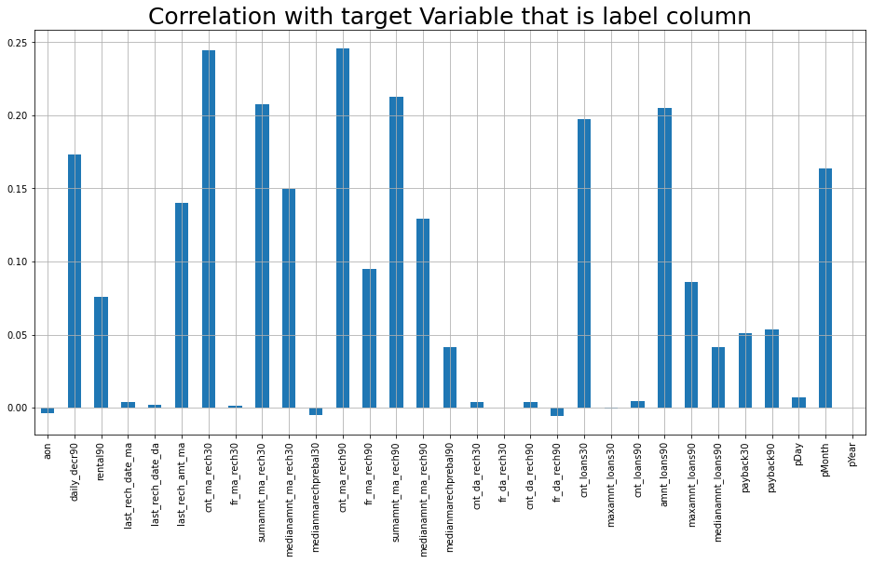
Correlation with target variable

Slide 5
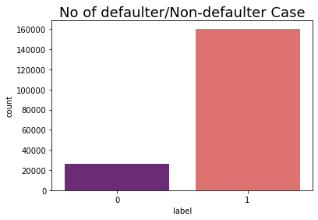
No of defaulter

Slide 6
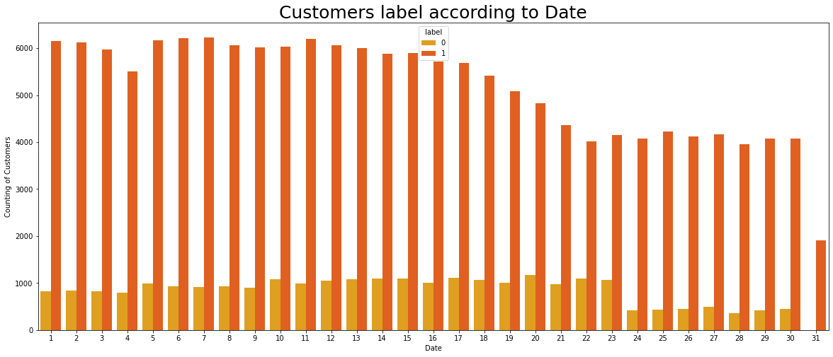
Customer Label according to Date

Slide 7
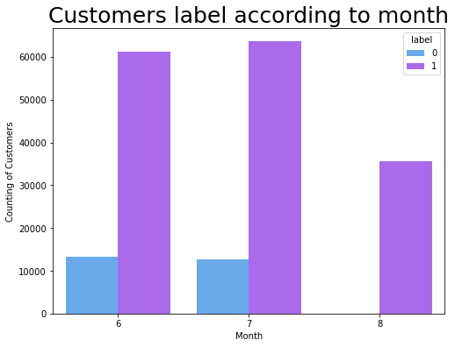
According to month

Slide 8
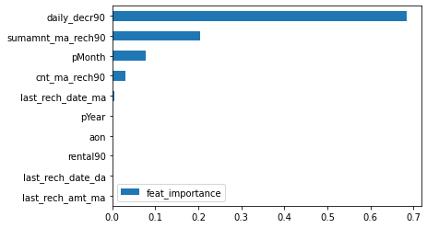
Decision Tree Classifier

